Slide 1
Tech Day 2018: iControlLX Extensions Overview
Kevin Reynolds, Consultant

Slide 2
Agenda
Launch Your Deployment
What is iControl LX?
Building and Installing Workers
Anatomy of a Worker
F5 iControlLX Framework and basic JS Concepts
API Service Gateway Container
Example Current Use Cases

Slide 3
Goals
Familiarity with what platforms can run iCLX
Comfortable with packaging and Installing workers
Understanding worker events and restWorker and restOperation classes
Interact with current PD examples
AS3 primer
Very little writing of JS needed***
Notes:
*** is for some extra credit assignments
Gauge the familiarity with JavaScript/Node during this slide. Go around the horn and ask level of familiarity, previous projects, etc.

Slide 4
What is iControlLX?
This Session
Notes:
iControl® LX is the foundation of the F5 control plane extensibility layer.
::talk about data plane tools like iRules, iRulesLX for a minute
By writing an iControl extension in JavaScript, you can create a new REST API that exposes a custom URI that you can then call in a RESTful manner.
The iControl Framework consists of the following components:
iControl LX (Framework) - The base layer of the iControl architecture managing access to API components.
iControl REST - The BIG-IP/ iControl REST control plane APIs.
iControl LX Extensions - The extensibility layer for creating extensions to produce custom APIs on the BIG-IP and iWorkflow.
Extensions - F5 and end user developed API extensions.

Slide 5
What is iControl LX?
Like what iRules did for the data plane
Foundation of F5’s programmable extensibility layer
Out-of-band customizations
Supported on BIG-IP and REST proxy container
Packaged as RPM files
Utilizes restnoded service/daemon
Notes:
iControl LX allows for out-of-band customizations to the control plane just as iRules did for the data plane. It enables you to build custom extensions to address unique customer requirements including dynamic VIP fetching, automated provisioning, HA pairing, and much more.
iControl LX is now GA running on iWorkflow 2.3 and BIG-IP 13.1 (Evergreen) coming later this year.
iControl LX provides the foundation for F5’s programmable extensibility layer, enabling users to extend and create fundamentally new platform capabilities. It enables you to run Node.js “extensions” on BIG-IP and iWorkflow which enable custom behaviors at new iControl REST API endpoints. These extensions can be initiated and controlled by calling their new REST API endpoints.

Slide 6
What does it do?
Extends fundamental platform capabilities
Enables you to create and run Node.js-based “extensions”
Creates new iControl REST API endpoints for custom behaviors
Controls extensions via calling their new REST endpoints
Notes:
iControl LX allows for out-of-band customizations to the control plane just as iRules did for the data plane. It enables you to build custom extensions to address unique customer requirements including dynamic VIP fetching, automated provisioning, HA pairing, and much more.
iControl LX is now GA running on iWorkflow 2.3 and BIG-IP 13.1 (Evergreen) coming later this year.
iControl LX provides the foundation for F5’s programmable extensibility layer, enabling users to extend and create fundamentally new platform capabilities. It enables you to run Node.js “extensions” on BIG-IP and iWorkflow which enable custom behaviors at new iControl REST API endpoints. These extensions can be initiated and controlled by calling their new REST API endpoints.

Slide 7
Module0 – Environment Overview
Notes:
Launch

Slide 8
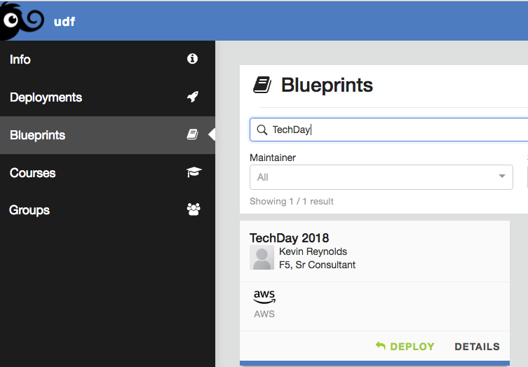
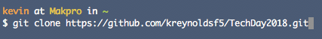
Launch Your Deployment
https://udf.f5.com/blueprints
Notes:
Clone the repo locally if you want or browse along on github.
It should take 4-5 min for the deployment to boot.
Tools:
Standard Putty/WinSCP
Postman
Visual Studio Code

Slide 9
Module1 – Structure and Build

Slide 10
JavaScript/Node.js (brief) Overview
Notes:
No way we can cover JS in any detail
Goal of this session is not to become a JS/node expert. The goal is familiarity with iCLX workers, get you dangerous enough to write your own, with some reference/examples

Slide 11
Javascript “Simple Types”
Numbers
Strings
Booleans
Null
Undefined
Object
Function
Array
Date
RegExp
JS is dynamically typed…
Notes:
Javascript is a weakly typed or dynamically typed.
For example, java is strongly typed. Objects of one type must be cast to another.
TCL is typeless – this makes sense as its essentially a scripting language.
Point of this slide is show datatypes formed the basis of JSON.
Example: https://repl.it/@kreynoldsf5/1-DynamiclyTyped

Slide 12
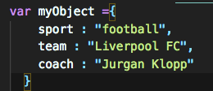
JavaScript Concept: Object Literal Notation
Key Value Pairs
Wrapped in curly braces
Comma delimited
Notation Example
This looks strangely familiar…
Notes:
Also called Object initializers.
EVERYTHING IS AN OBJECT!!!
A couple different syntaxes here -- dot notation and object Literal Notation
The Object literal notation is basically an array of key:value pairs, with a colon separating the keys and values, and a comma after every key:value pair, except for the last, just like a regular array. Simple values are properties.
Remember that you don’t have to name your functions. Values created with anonymous functions are methods of just your object.
FUNCTIONS are first class objects. They can be passed around, assigned to variables, be properties of an object.
Robin Popplestone gave the following definition: All first class objects have certain fundamental rights:
1. All items can be the actual parameters of functions
2. All items can be returned as results of functions
3. All items can be the subject of assignment statements
4. All items can be tested for equality.
https://repl.it/@kreynoldsf5/ObjectLiteral

Slide 13
JavaScript Concept: Prototypes
Prototype Example.
Notes:
The name prototype comes from the idea that in JavaScript, every object is created as a copy of an existing example (that is, a prototype) object. Any properties and methods of this prototype object will appear as properties and methods of the objects created from that prototype’s constructor. You can say that these objects inherit their properties and methods from their prototype.
The prototype object for an iControlLX extension is a restWorker – a object type defined by the iControlLX framework. Essentially, this is what restnoded needs in order to perform its function.
Inheritence
Every object in Javascript has a prototype. When a messages reaches an object, JavaScript will attempt to find a property in that object first, if it cannot find it then the message will be sent to the object’s prototype and so on (up the inheritance chain). So if we ask ”what’s the color of ‘Cat’?” we’d check the Cat object and see its not defined and then we’d check the prototype and we’d learn the answer is “Black”.
For iControlLX extensions this can be pretty simple. The restWorker instance object inherits from the class definition.

Slide 14
JavaScript Concept: Prototypes
Prototype Inheritance Example
Notes:
Suppose we want to add another function to Cat, after we have defined it. Prototype is a type of inheritance in JavaScript. We can do that outside of the initial constructor and it will be inherited.
I point this out because this is, basically, the structure used in iControlLX workers.

Slide 15
Module 2 – iControl LX Worker Overview
Notes:
Key to node/JS performance is its non-blocking IO model. If you have several network calls that need to be made, they can all happen simultaneously.
Quote: everything about Javascript is asynchronous, except for your code.
Let me explain that for a minute:
In programming languages like e.g Java or C# the “main program flow” happens on the main thread or process and “the occurrence of events independently of the main program flow” is the spawning of new threads or processes that runs code in parallel to the “main program flow”.
This is not the case with JavaScript. That is because a JavaScript program is single threaded and all code is executed in a sequence, not in parallel. In JavaScript this is handled by using what is called an “asynchronous non-blocking I/O model”. What that means is that while the execution of JavaScript is blocking, I/O operations are not. I/O operations can be fetching data over the internet with Ajax or over WebSocket connections, querying data from a database such as MongoDB or accessing the filesystem with the NodeJs “fs” module. All these kind of operations are done in parallel to the execution of your code and it is not JavaScript that does these operations; to put it simply, the underlying engine does it.

Slide 16
What does a worker need to do?
Accept a incoming REST call
Do *something* with that REST call
Respond to the request
Notes:
What does it need to do?
Accept a REST call.
DO something with that rest call – whatever the point of the worker might be.
Respond to the REST call.
Step 2 can get a little complicated.

Slide 17
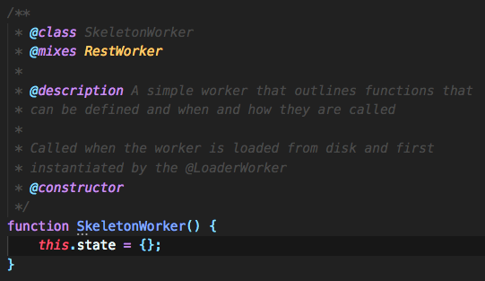
What is a Worker?
Just an instance of a type of JavaScript object
@class: RestWorker
Notes:
All workers are simply a specific type of JS object – that F5 has defined called restWorker.
The restnoded framework makes calls to functions in RestWorker.
When your looking at the code of a worker remember the keyword “this” refers to this instance of the RestWorker object. Its frequently said that “this” owns all subsequent objects of “this” object.
Why Node.js?
Javascript outside the browser, an event-driven, non-blocking I/O model …because of that its perfect for network applications.
Network applications are typically light on CPU and heavier on network latency. The non-blocking IO module is key to timely execution.

Slide 18
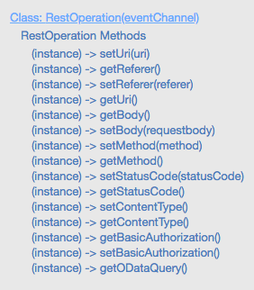
restWorker Structure
Properties
Events
restOperation object should be passed into on{{HTTP verb}}
Response
restWorker.completeRestOperation(restOperation)
YEP – that is typically the same restOperation object.
When your worker is loaded its “mixed in” to a base restWorker.
Notes:
We don’t need to implement the structure – the restWorker object is well defined.
The Object has various defined properties
Restnoded executes the worker in an event driven framework. Not suprisingly these events are largely organized around HTTP request events.
A restOperation object is passed into the on* HTTP verb events.
restWorker has a method to “complete” the operation. So we just need to pass a restOperation object into that method to conclude the event.
Example “getters” and “setters” for the restOperation class. THIS LIST IS LIKELY INCOMPLETE – the documentation is still a work in progress.

Slide 19
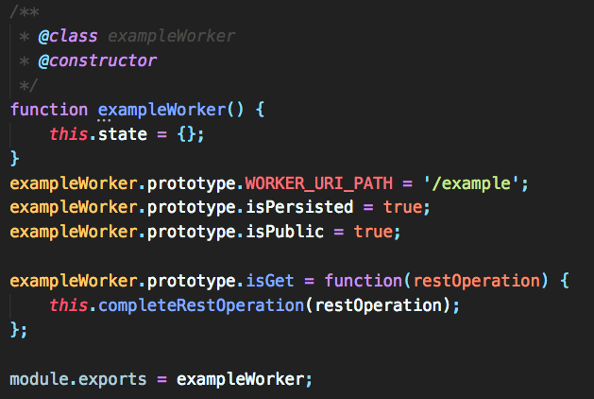
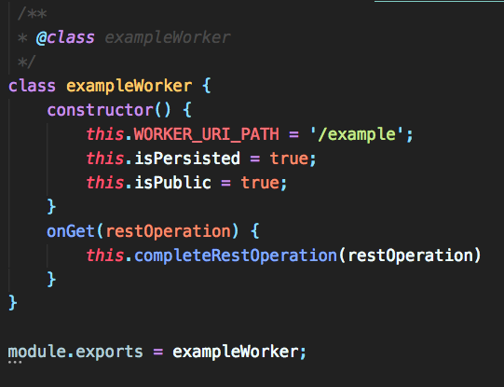
restWorker.prototype vs. class constructor()
functionally the same (for restWorker)
Notes:
In the first approach we declare a function. When a function is created in JavaScript, JavaScript engine adds a prototype property to the function. This prototype property is an object (called as prototype object) has a constructor property of its own.
The constructor method is a special method for creating and initializing an object created within a class.
For the way workers get mixed in with restWorker these methods are functionally the same. (technically there would be a difference when multiple object are created – in the first example they would share the prototype properties

Slide 20
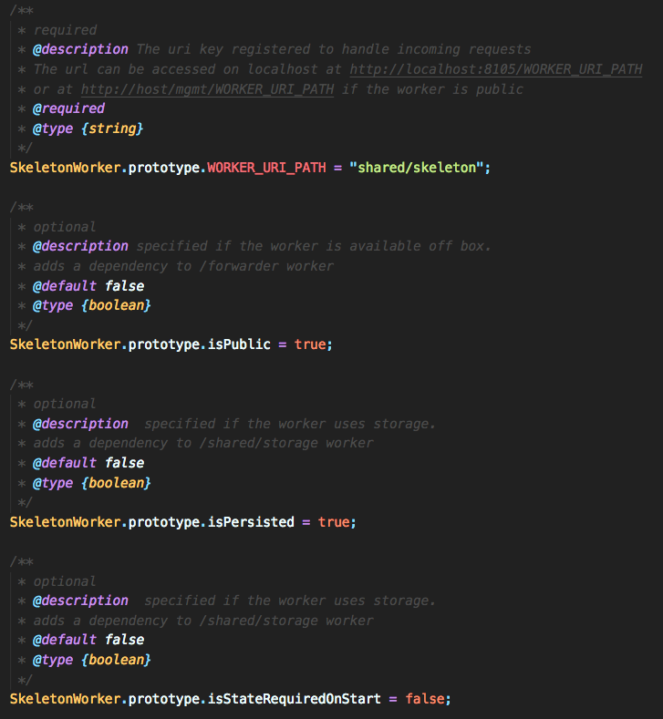
restWorker Properties
Notes:
In this example, we’ve defined prototype values for several properties of our RestWorker. When its instantiated (when loaded off the disk) it will have these properties.
WORKER_URI_PATH: where it fits into the REST API
isPublic: is it available off the box?
isPersisted: should the state of the worker be persisted?
isStateRequiredOnStart: should persisted state be loaded onStart as opposed to on demand.
Hint: there are some workers already here used for things like storage

Slide 21
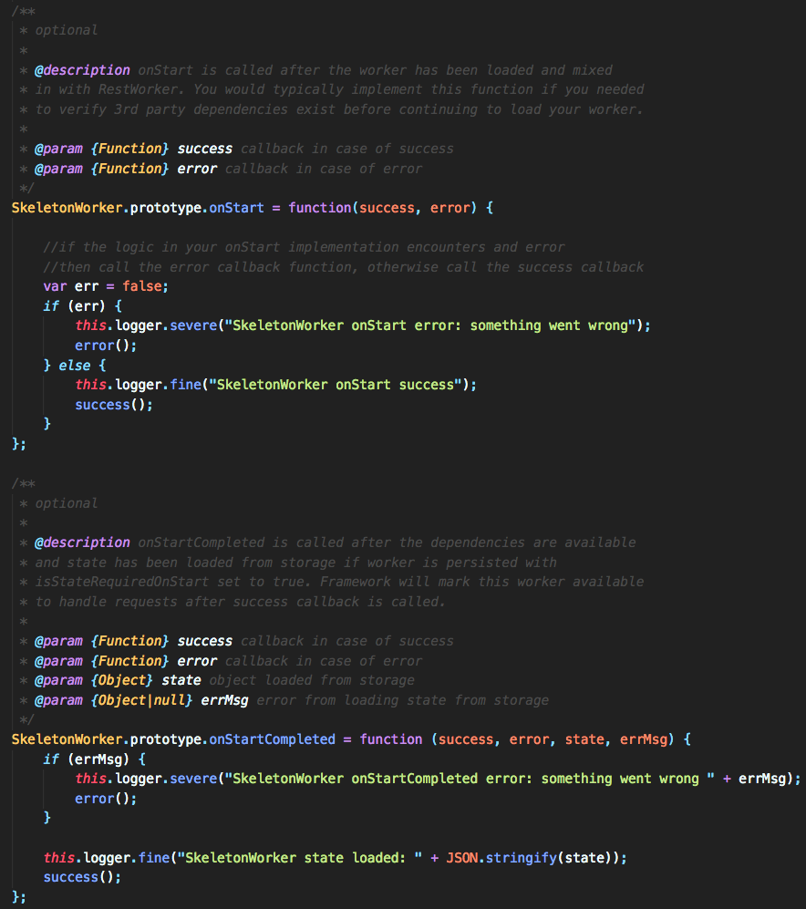
restWorker Events
onStart
Define dependent workers
onStartCompleted
onStart is done
State has been returned from storage

Slide 22
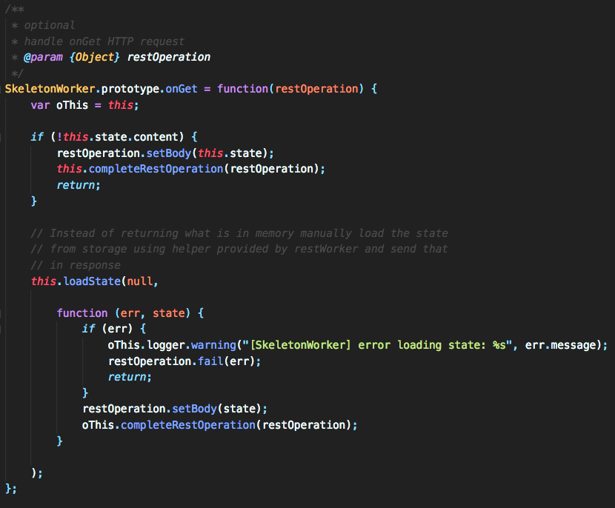
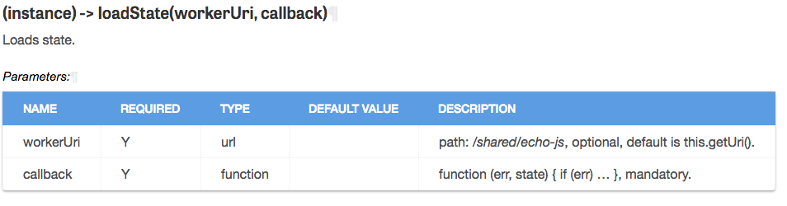
Worker Events
onGet
Notes:
Talk about the restOperation being passed into the event
oThis = this
//Creates a new restWorker (remember prototype inheritance)
Checks to see if we have “content” in our current state (was there a POST before this GET with content?). If not we return the current state.
When persisted worker calls completeRestOperation method, restOperation (response) body is automatically persisted (/shared/storage helper worker) and key is this worker URI. So if someone had previously POSTed to the worker to set some content, that content would be stored in the worker’s state. To retrieve that state we need to use the loadState method (its not safe to pull it from this.state because of consistency issues – we need to prevent in-memory state going out of sync with persisted state.).

Slide 23
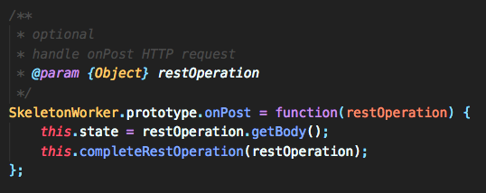
Worker Events
onPost
Notes:
Notice how this.state is updated with restOperation.getBody();
JSON is understood natively – you could access payload/body with this.state.{{json_parameter}}

Slide 24
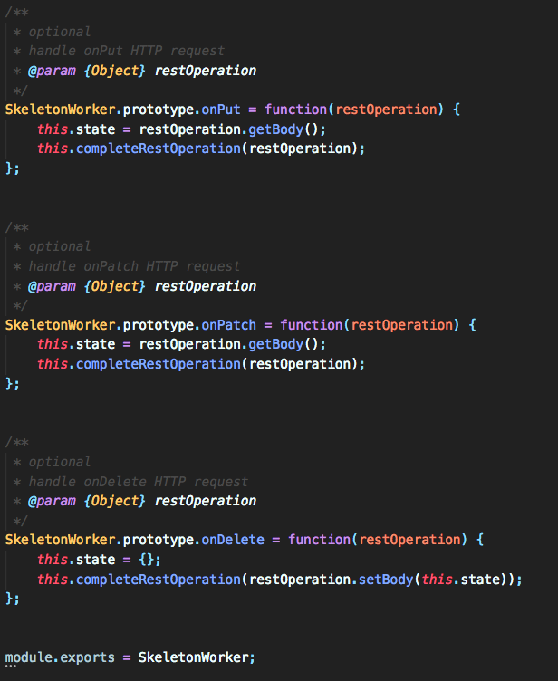
Worker Events
You can see onPut and onPatch aren’t exactly implemented
module.exports = {{worker}}
Notes:
Notice that onPut and onPatch are not doinganything differently than onPost.
onDelete sets the state to an empty object.
This ends the worker

Slide 25
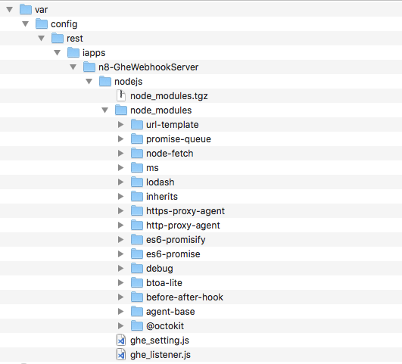
RPM Packaging
Notes:
Structure of an example RPM.
/var/config/rest/iapps/{{extension name}}
Your JS files go in the nodejs directory.
Notice that you can package node modules (from NPM) with your workers. From the nodejs directory of the worker you can run:
npm install {{package}} –-save
You can package workers from a BIG-IP.

Slide 26
Lab Modules 1,2

Slide 27
Module 3 – Asynchronous JS Concepts
Notes:
Key to node/JS performance is its non-blocking IO model. If you have several network calls that need to be made, they can all happen simultaneously.
Quote: everything about Javascript is asynchronous, except for your code.
Let me explain that for a minute:
In programming languages like e.g Java or C# the “main program flow” happens on the main thread or process and “the occurrence of events independently of the main program flow” is the spawning of new threads or processes that runs code in parallel to the “main program flow”.
This is not the case with JavaScript. That is because a JavaScript program is single threaded and all code is executed in a sequence, not in parallel. In JavaScript this is handled by using what is called an “asynchronous non-blocking I/O model”. What that means is that while the execution of JavaScript is blocking, I/O operations are not. I/O operations can be fetching data over the internet with Ajax or over WebSocket connections, querying data from a database such as MongoDB or accessing the filesystem with the NodeJs “fs” module. All these kind of operations are done in parallel to the execution of your code and it is not JavaScript that does these operations; to put it simply, the underlying engine does it.

Slide 28
Callback Functions
Functions passed as arguments to other functions
Simple callback example
Why do we actually need callbacks?
HTTP example 1
HTTP example 2

Slide 29
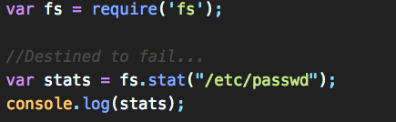
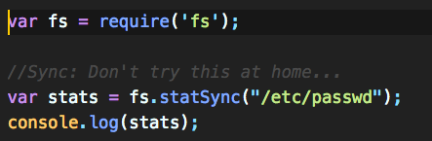
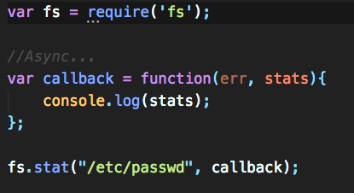
Callbacks
Why do we actually need callbacks?
HTTP example 1
HTTP example 2

Slide 30
Callback Hell
What if you need to nest callbacks?
A better way exists…
Notes:
Nesting callbacks can lead to serious readability problems. This anti-pattern is referred to as callback hell.

Slide 31
Promises
Associated Methods
.then()
.catch()
Promise State
.isFulfilled()
.isPending()
.isRejected()
HTTP Example
Notes:
A promise is an object that wraps an asynchronous operation and notifies when it’s done. This sounds exactly like callbacks, but the important differences are in the usage of Promises. Instead of providing a callback, a promise has its own methods which you call to tell the promise what will happen when it is successful or when it fails. The methods a promise provides are “then(…)” for when a successful result is available and “catch(…)” for when something went wrong.
https://repl.it/@kreynoldsf5/HTTPpromise

Slide 32
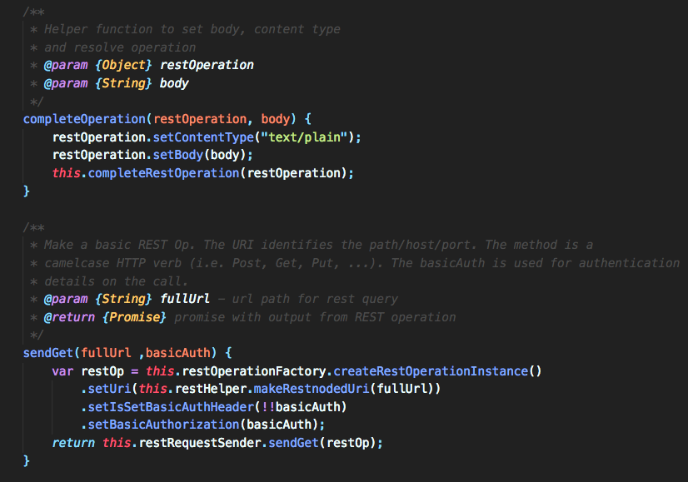
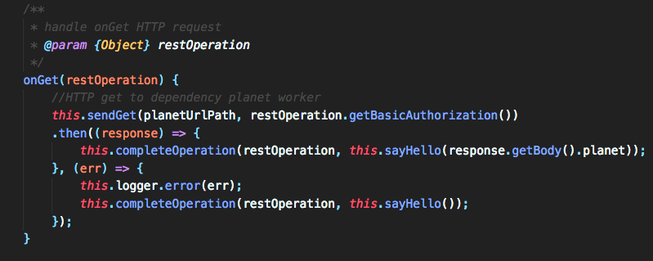
Example Promise use in restWorker
Notes:
In the patterns for the previous workers you packaged and deployed, the restOperation being passed into the event was the same object given to completeRestOperation to conclude the event. What if you need to make another REST call as part of your worker?
In this example, we’ve created a couple helper functions:
completeOperation just simplifies calling completeRestOperation.
The sendGet wraps around the existing restRequestSender sendGet method. THIS METHOD RETURNS A PROMISE.
We instantiation a new restOperation instance
Set some properties on it
Return a promise for the REST call
The onGet event then uses this function. We pass in the URL to be called and auth. Remember that this.sendGet is a promise.
We then call the .then method on that promise and pass the response into our function which ultimately “completes” the restOperation.
THIS IS A REALLY COMMON PATTERN. You will see variants of this pattern in PD written workers.

Slide 33
Lab Module 3

Slide 34
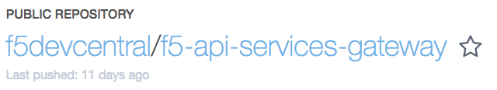
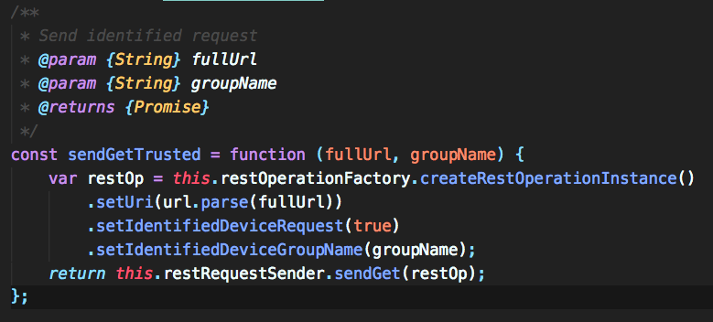
API Services Gateway (aka REST proxy container)
This is just restjavad and restnoded – tmm is not required
All the same services, nicely packaged in a container.
Access BIG-IPs using “identified device” calls
Notes:
API services gateway is running a newer version of restnoded. This has some new features for restWorker.
These features will make it into flatrock. They are, as of yet, not documented or not properly documented. Eric Flores is responsible for updating/publishing this documentation.
For example,
.setIdentifiedDeviceRequest matches the fullURL against the list of ”discovered” devices. THIS IS ALL YOU HAVE TO DO FOR AUTH in the container assuming the device has been discovered. That’s really cool….and also not documented.

Slide 35
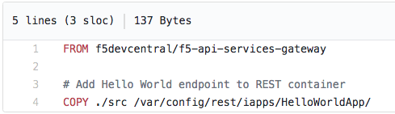
API Services Gateway
Flexibility
Run in Docker, Kubernetes, any LXC env
Spawn, run workload, terminate
Make your workers available
DockerFile
Mount a Volume
Notes:
UPDATED FRAMEWORK VERSION.
PD certainly sees this as the direction for many customer….removing their automation logic from the BIG-IP where appropriate.

Slide 36
isSingleton (and the sorry state of iControlLX documentation)
Singleton and Collection workers are GA in Flatrock
Common design pattern
A single document, two functions:
getDefaultState()
getSchema()
How would you ever know the requirements?
Notes:
Typically, the singleton design pattern is a way to restrict instantiation of a class to one (single) object. Typically, In JavaScript, Singletons serve as a shared resource namespace which isolate implementation code from the global namespace so as to provide a single point of access for functions.
As far as I can tell….the iControlLX singleton pattern is more like “HERE IS A SINGLE DOCUMENT” with some special properties.
HOW WOULD YOU EVER KNOW THE REQUIREMENTS?
A little reverse engineering and then I ASKED THE DAMN DEVELOPER in PD.

Slide 37
Lab Module 4

Slide 38
Solution: iControl LX Declarative Interface
New LX-enabled declarative REST ‘/ipamDeploy’ endpoint
Ops requests service definition app1.xyz.com for servers a, b, c
1
IPAM
iControlLX
2
1
LX extension /deploy fetches VIP address from IPAM system
/mgmt/ipamDeploy
2
/mgmt/cloud/connector
3
iControl REST
restjavad
F5 iApp
F5 BIG-IP
/deploy populates iApp app1 with acquired VIP and deploys to BIG-IP
/mgmt/custom_worflow1
Ops
3
4
LX extension ‘/ipamDeploy’ loaded by restnoded, presented via iControl REST API
/deploy creates DNS entry for VIP address in BIG-IP DNS
F5 BIG-IP DNS
4
restnoded
iControlLX
Framework
Notes:
Using the iControl LX Framework, a declarative interface ‘/deploy’ was created which dynamically fetches VIP addresses from an IPAM service during deployment. The IP address is then inserted into an iApp, with the server addresses, and deployed to a BIG-IP before finally registering the new service with BIG-IP DNS.

Slide 39
Solution: OAP
Ops requests service definition app1.xyz.com for servers a, b, c. Either through Master Orchestrator or directly into the OAP platform
NetOps/DevOps
Logging
Ticketing
Email
1
IPAM
1
1
2
5
DNS LX extension fetches VIP address from IPAM system
2
Master Orchestrator
(Ansible, Puppet, Chef)
3
OAP VIP LX ext populates service configuration with acquired VIP and deploys to BIG-IP
API Call
OAP Platform
F5 BIG-IP
3
OAP LX ext populates configuration with DNS entry for VIP address in BIG-IP DNS
4
4
iControlLX
Framework
F5 BIG-IP DNS
OAP LX Ext to communicate changes to the different logging, ticketing and email mechanisms
5
Notes:
Discuss support structure for the pilot
Utilizing our PM resources to track the engagement planning, design and deployment

Slide 40
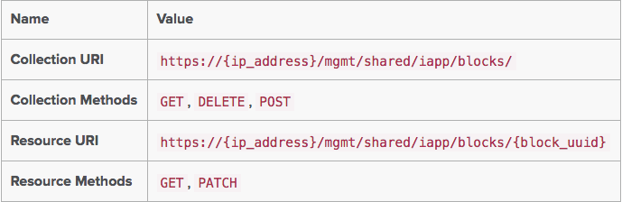
PD Provided Workers
Device Service Clustering Package API
Big-IP Settings iControl Extension API
Updated for the API Services Gateway
Built on block interface/ ConfigProcessor pattern
Notes:
A “block” is a method to keep state (technically part of the iAppLX features, I believe). These blocks are shared (ie. they are in a common location).
A block contains all the information needed for the worker to do it job – its just a large block of JSON.
It has a configurationProcessorReference property which tells the system which config processor should handle the block.
It has a “state” property that is updated by the config processor.
When you create a block you set the state to “BINDING”. This tells the configProcessor that it has work to do. When its done it sets the state to “BOUND”.
This is rather like the building/installing an RPM process. You kick off the task and then periodically check its progress.

Slide 41
Lab Module 5

Slide 42
Lab Module 6 (if we get here)

Slide 44
Solution: OAP
/mgmt/cloud/connector
Notes:
Using the iControl LX Framework, a declarative interface ‘/deploy’ was created which dynamically fetches VIP addresses from an IPAM service during deployment. The IP address is then inserted into an iApp, with the server addresses, and deployed to a BIG-IP before finally registering the new service with BIG-IP DNS.

Slide 45
Declarative Interface w/ 3rd party integration
REST Client
iControlLX extension (on iWorkflow)
SERVICE_REQUEST:
Service Name (DNS):
app1.xyz.com
Service Template (iApp/iWorkflow):
app_type-abc-v1.1a
Pool addresses: x.x.x.x
y.y.y.y
z.z.z.z
POST: SERVICE_REQUEST
IPAM
IN_PROGRESS
GET: VIP Address
ADDRESS
POST: VIP/Pool Addresses + SERVICE_TEMPLATE
BIG-IP LTM
COMPLETE
POST: DNS CNAME
BIG-IP DNS
COMPLETE
GET: SERVICE_REQUEST_STATUS
SERVICE_PROVISIONED
Notes:
Validated with Nicolas Menant – May 16th, 2017

Slide 46
Definitions
Programmability:
“Programmability” refers to capabilities that allow a program or script to control or extend a system’s capabilities (hardware/software).
2 Types:
Programmability Control:
Allows a program or script to retrieve and configure operational characteristics of F5 systems.
Programmability Extensibility:
Allows the capabilities of both the data- and control-planes of F5 systems to be extended beyond the formal product design specifications.
iControl LX
Notes:
Programmability Control:
Allows a program or script to retrieve and configure operational characteristics of F5 systems.
Examples: iControl REST, iControl SOAP, TMSH, Python “SDK”, and our Ansible Playbooks.
Programmability Extensibility:
Allows the capabilities of both the data- and control-planes of F5 systems to be extended beyond the formal product design specifications.
Examples: iRules ,iRules LX, iControl LX, iApps, and iApps LX

Slide 47
MANOVA Strategy & Roadmap 2017-2018
Drive increased customer business agility by enabling customers to simply & consistently manage, orchestrate & secure their applications with F5 products & services that deliver the highest net value wherever they are deployed.
Eco-System
Containerized iControlLX & AppServices iApp
iWorkflow
Enabling Super-NetOps with F5 MANOVA Products & Tools
MANOVA Customer Demos
BIG-IQ 6.1
BIG-IQ
BIG-IQ 6.0
May MANOVA Release
Full App Services Lifecycle support
Horizontal scale
Analytics
Major App Services iApp use cases
Security Central Management
BIG-IQ extensibility thru
iControl LX container integration
Python REST exts & Ansible integrations
BIG-IQ 5.4 December
App-IQ
Multi Cloud Application Security (MCAS)
Risk Engine
FY19
Management, Orchestration, Visualization and Analytics (MANOVA)

Slide 48
iWorkflow Migration Timeline
ISC FY18
ISC FY19
BIG-IQ and Ecosystems equivalence assessment by F5 Field leaders
BIG-IQ & Ecosystems releases substituting desired iWorkflow capabilities
MANOVA Update
Feb ‘19
Oct-Dec ‘17
Jan-Mar ‘18
Apr-June
July-Sept
Oct-Dec
iWorkflow End-of-Sale announcement
iWorkflow End-of-Sale
iWorkflow End-of-Life
Support
PD Support (Bug fixes ONLY)
Tech Support
SKU Availability

